Slide 1
Improvements to Polynomial Multiplication Through Fast Fourier Transforms
David Lambropoulos
Demetrios Lambropoulos

Slide 2
Contents
Introduction/Motivation
Theory/Algorithms
Experimental Setup
Results and Analysis
Discussion

Slide 3
Contents
Introduction/Motivation
Theory/Algorithms
Experimental Setup
Results and Analysis
Discussion

Slide 4
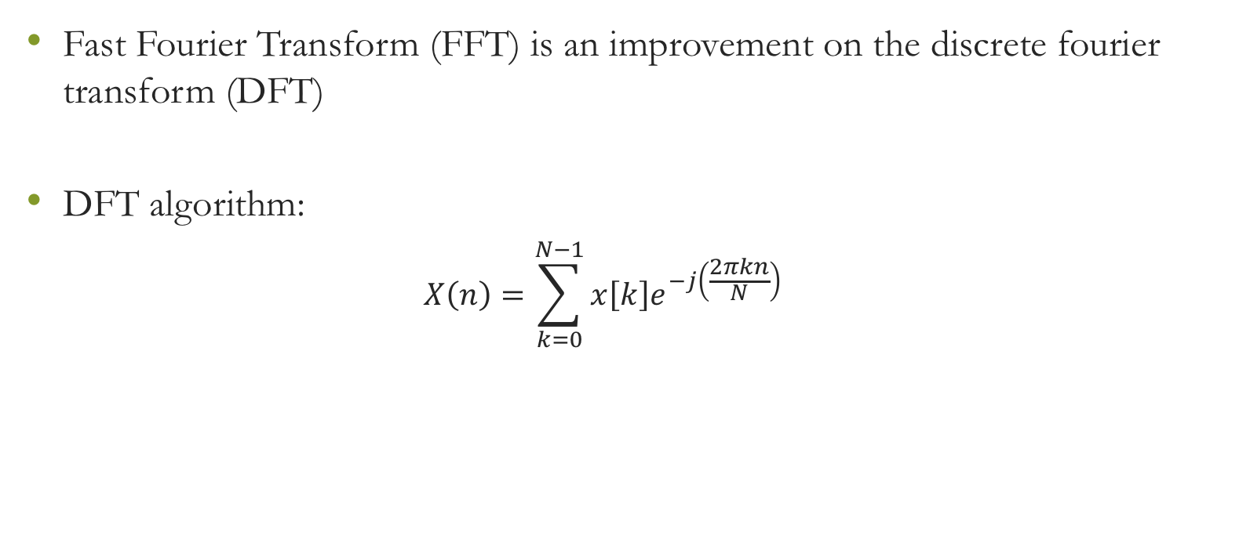
Introduction/Motivation
Fast Fourier Transform (FFT) is an improvement on the discrete fourier transform (DFT)
DFT algorithm:
$$X\left(n\right)=\sum_{k=0}^{N−1}{x\left[k\right]e^{−j\left(\frac{2πkn}{N}\right)}}$$

Slide 5
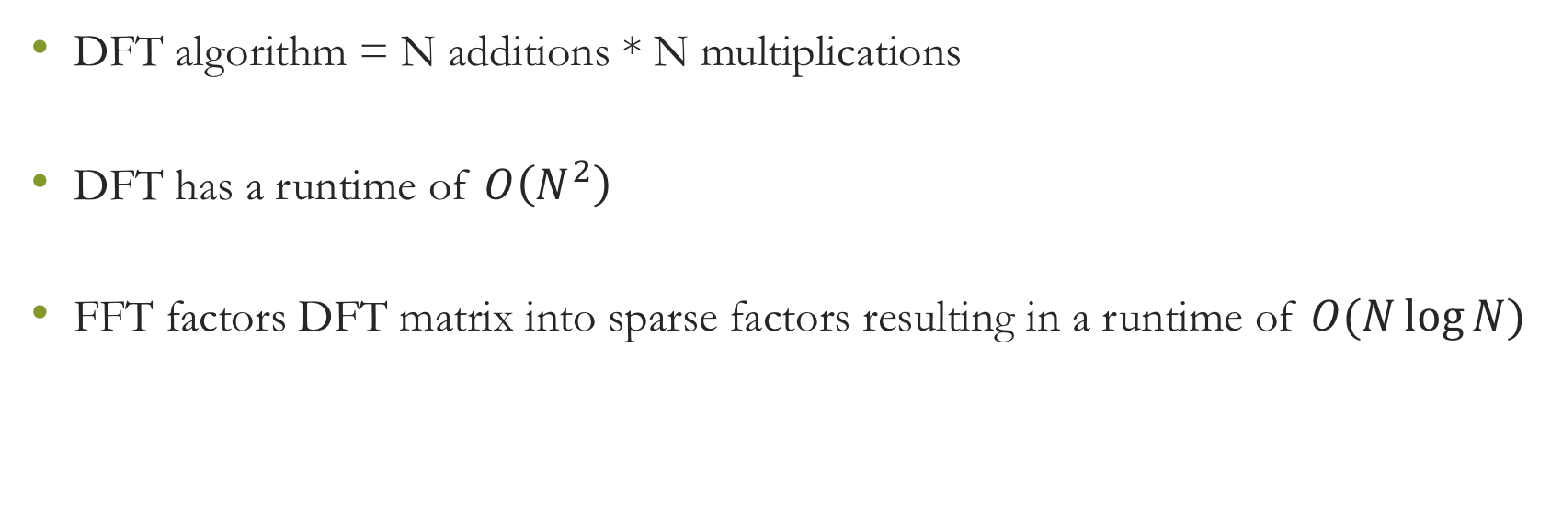
Introduction/Motivation
DFT algorithm = N additions * N multiplications
DFT has a runtime of $O\left(N^{2}\right)$
FFT factors DFT matrix into sparse factors resulting in a runtime of $O(N\log{N})$

Slide 6
Introduction/Motivation

Slide 7
Contents
Introduction/Motivation
Theory/Algorithms
Experimental Setup
Results and Analysis
Discussion

Slide 8
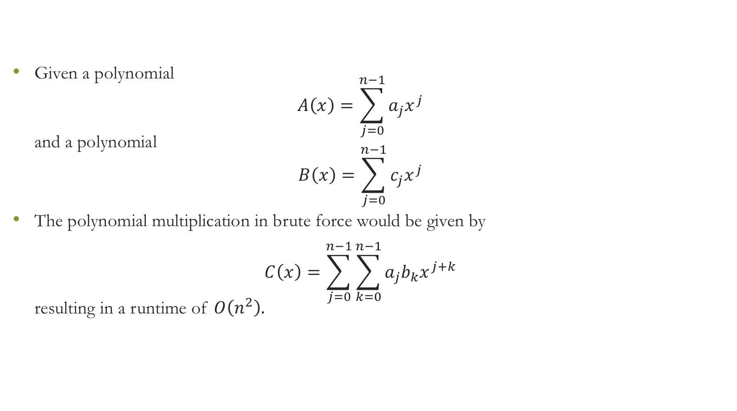
Theory/Algorithms – Brute Force
Given a polynomial $A\left(x\right)=\sum_{j=0}^{n−1}{a_{j}x^{j}}$ and a polynomial $B\left(x\right)=\sum_{j=0}^{n−1}{c_{j}x^{j}}$
The polynomial multiplication in brute force would be given by $C\left(x\right)=\sum_{j=0}^{n−1}{\sum_{k=0}^{n−1}{a_{j}b_{k}x^{j+k}}}$ resulting in a runtime of $O\left(n^{2}\right).$

Slide 9
Theory/Algorithms – Fast Fourier Transform
Let m = 2n – 1
Pick m points

Slide 10
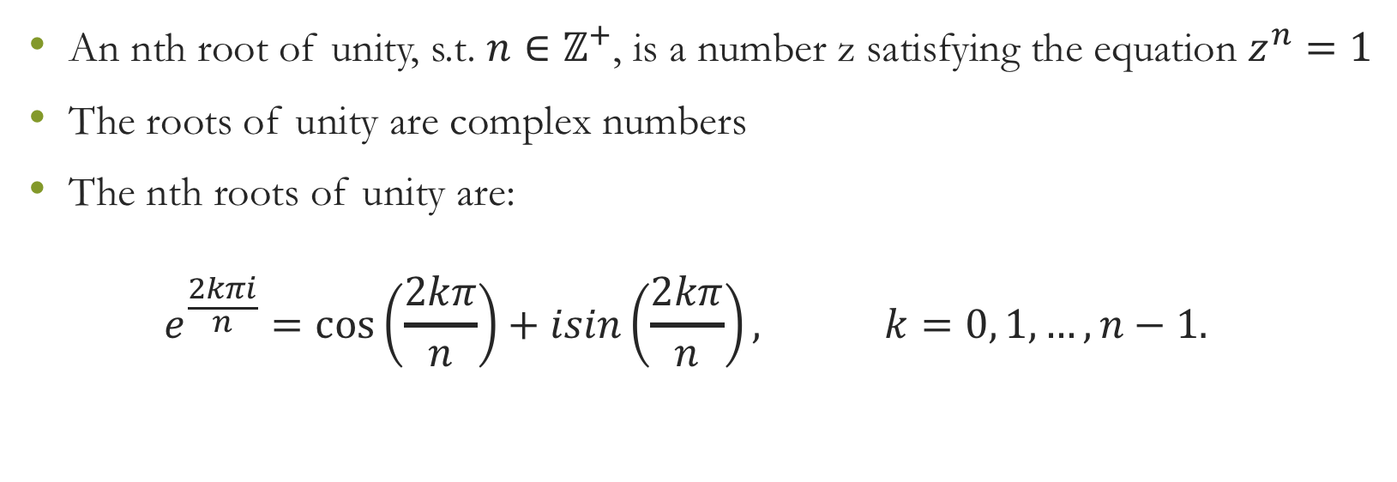
Theory/Algorithms – Roots of Unity
An nth root of unity, s.t. $n∈ℤ^{+}$, is a number z satisfying the equation $z^{n}=1$
The roots of unity are complex numbers
The nth roots of unity are: $e^{\frac{2kπi}{n}}=\cos\left(\frac{2kπ}{n}\right)+isin\left(\frac{2kπ}{n}\right), k=0, 1, …, n−1.$

Slide 11
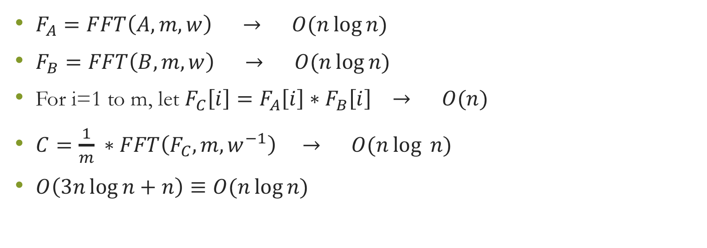
Theory/Algorithms – Final Algorithm
$F_{A}=FFT\left(A, m, w\right) → O(n\log{n)}$
$F_{B}=FFT\left(B, m, w\right) → O(n\log{n})$
For i=1 to m, let $F_{C}\left[i\right]=F_{A}\left[i\right]∗F_{B}\left[i\right] → O(n)$
$C=\frac{1}{m} ∗FFT\left(F_{C}, m, w^{−1}\right) → O(n\log{ n})$
$O\left(3n\log{n}+n\right)≡O(n\log{n})$

Slide 12
Contents
Introduction/Motivation
Theory/Algorithms
Experimental Setup
Results and Analysis
Discussion

Slide 13
Experimental Setup

Slide 14
Contents
Introduction/Motivation
Theory/Algorithms
Experimental Setup
Results and Analysis
Discussion

Slide 15
Results and Analysis

Slide 16
Results and Analysis

Slide 17
Contents
Introduction/Motivation
Theory/Algorithms
Experimental Setup
Results and Analysis
Discussion

Slide 18
Discussion

